Slide 1
Validation, Pitfalls and Reporting of Prediction Modelling
Dr Glen Martin
glen.martin@manchester.ac.uk

Slide 2


Validation of Prediction Models
This is a dense topic and a very active research field.

Slide 3
The CPM Pipeline
Model Development
Validation/ Testing Predictive Performance
Impact Assessment
Implement CPM in practice

Slide 4
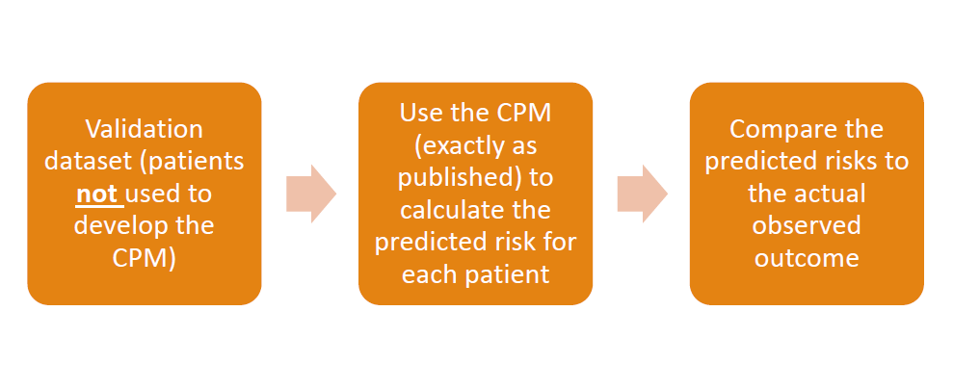
Validation of a Prediction Model

Slide 5
In-sample Optimism
The model is developed to work “optimally” within the development/derivation dataset
Therefore, it is inappropriate to assess predictive performance within the same data
Any such performance estimates will be overly optimistic
We need to test how the model works on new (“unseen”) patients – i.e. robust internal and external validation

Slide 6
Internal and External Validation
Internal Validation: When assessing performance in similar data to that used to develop the model
E.g. split-sample, cross-validation, bootstrapping
External Validation: means assessing the performance of a CPM in a context that is different in some way:
E.g. geographically different, temporally different
Used to assess generalisability of the CPM

Slide 7
Internal Validation: Cross-Validation
For example 5-fold cross validation:
Fold 1 | Fold 2 | Fold 3 | Fold 4 | Fold 5
Develop the CPM
Test/Validate the CPM

Slide 8
Internal Validation: Cross-Validation
For example 5-fold cross validation:
Fold 1 | Fold 2 | Fold 3 | Fold 4 | Fold 5
Develop the CPM
Develop the CPM
Test/Validate the CPM

Slide 9
Internal Validation: Cross-Validation
For example 5-fold cross validation:
Fold 1 | Fold 2 | Fold 3 | Fold 4 | Fold 5
Develop the CPM
Develop the CPM
Test/Validate the CPM

Slide 10
Internal Validation: Cross-Validation
For example 5-fold cross validation:
Fold 1 | Fold 2 | Fold 3 | Fold 4 | Fold 5
Develop the CPM
Develop the CPM
Test/Validate the CPM

Slide 11
Internal Validation: Cross-Validation
For example 5-fold cross validation:
Fold 1 | Fold 2 | Fold 3 | Fold 4 | Fold 5
Develop the CPM
Test/Validate the CPM
After we have repeated this process across all folds, we take the average of the performance/validation results from each fold.

Slide 12
Internal Validation: Cross-Validation
Hence, split-sample is a special case of cross-validation, where we just divide the data into two groups, fit the data in one group and validate it in the other.
You will commonly see this in the literature, but should be avoided.
Fold 1 | Fold 2
Develop the CPM
Test/Validate the CPM

Slide 13

Internal Validation: Bootstrapping
Bootstrapping simply means sampling rows, with replacement, from an observed dataset to create a ‘mock’ dataset with the same number of rows.

Slide 14
Internal Validation: Bootstrapping
Bootstrap Validation Involves:
Derive the CPM on the full (raw) dataset
Sample rows (with replacement) from the raw data to create a bootstrap dataset
Derive a CPM in the bootstrap data (using identical analysis steps to 1)
Validate the model from step 3 within the bootstrap data
Validate the model from step 3 in the raw data
Subtract the performance metrics from step 4 with those from step 5 (i.e. calculate optimism)
Repeat steps 2-6 lots of times (e.g. >500 times), storing the optimism estimates
Average the optimism estimates
Validate the model from step 1 within the raw data and ‘subtract’ the average optimism estimate from step 8
Bootstrapping is the recommended approach to internally validating a CPM.
Notes:
This is the most efficient use of data, since all of the observations are used to develop the model, and appropriately using these observations to also internally validate the model.

Slide 15
External Validation
In external validation, we take a CPM (as published in the literature) and apply it directly to patients within the new (independent) dataset
Geographically different (e.g. if a model is fitted in the UK, does it predict well in the Netherlands?)
Temporally different (does a model fitted using data from 2000-2010 predict well from 2011 onwards?)
Different kind of patients (does a model developed on in-patients predict well in a primary care context?)
Some recommend that “pure” external validation needs to be performed by independent authors to those that developed the CPM
Notes:
External validation assesses whether the CPM has good generalisability, which is a useful indication that the model is robust, not overfitted, and meaningful.

Slide 16

Calibration & Discrimination
Calibration refers to whether the probabilities of outcome predicted by a CPM are accurate in the sense that, in a collection of patients who all have a probability $p$ of an outcome occurring, the outcome should occur in that proportion of them.
Discrimination refers to the ability of a CPM to separate patients who will develop an outcome from those who will not

Slide 17
Assessing Calibration
Hosmer-Lemeshow test
Calibration Plot
Logistic Calibration (calibration-in-the-large & calibration slope)
Observed Risk
Expected Risk

Slide 18

Assessing Calibration
Defines a hierarchy for assessing calibration, from weak to strong assessment

Slide 19
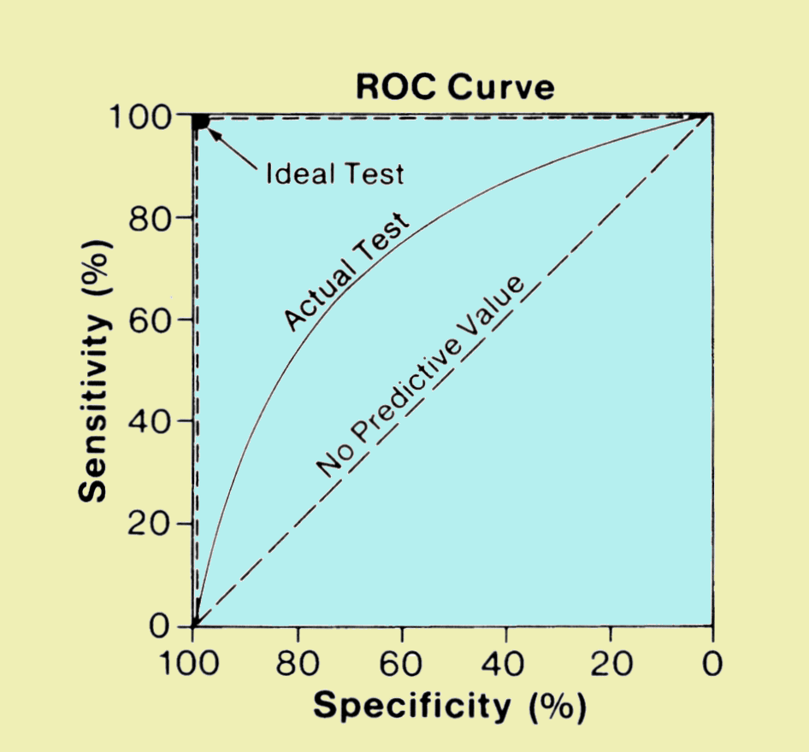
Discrimination
A CPM that can have a simultaneously high sensitivity and specificity has good discrimination.
However, the definition of sensitivity and specificity are a little limited for our purposes since they rely on a specific cutpoint.
A receiver operator characteristic (ROC) curve plots sensitivity against ‘1-specificity’ across the full range of potential cutpoints.
Notes:
Sensitivity: (a.k.a. true positive rate), measures the proportion of patients who had the outcome and were correctly identified as such by the CPM
Specificity: (a.k.a. true negative rate), measures the proportion of patients who did not have the outcome and were correctly identified as such by the CPM

Slide 20
Common Pitfalls in Clinical Prediction Model Research

Slide 21
Dichotomania
It is common in the medical literature to see continuous measures (e.g. age, body mass index, blood pressure,…) partitioned into groups.
For example: body mass index (BMI) categories (<18.5, 18.5-24.9, 25-29.9, 30-39.9, etc.)
The same is true in many CPM development studies, where a continuous variable will commonly be partitioned into categories.
For example, rather than including age as a continuous variable in the CPM, one frequently sees ‘age group’.

Slide 22
Dichotomania
…however, this should be avoided wherever possible, since it is incredibly wasteful of information and data.
“dichotomising a variable at the median reduces power by the same amount as would discarding a third of the data”
Douglas Altman

Slide 23
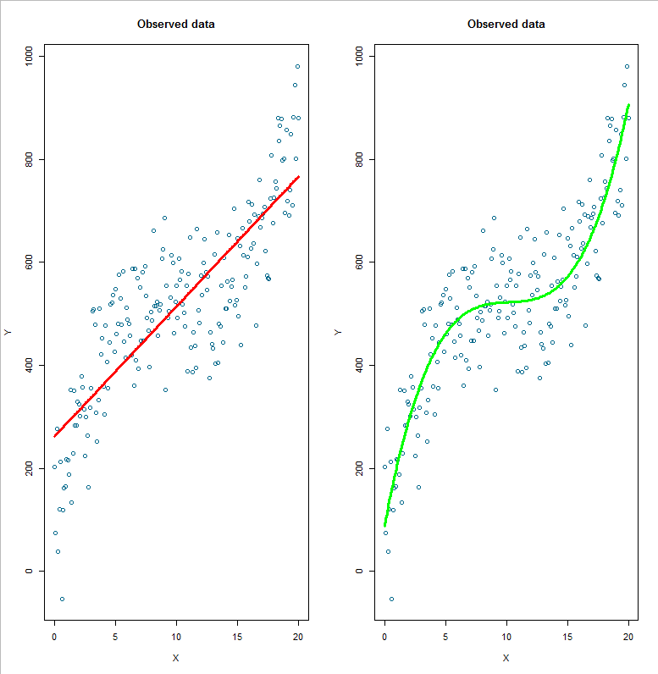
…Instead, model non-linear relationships explicitly

Slide 24
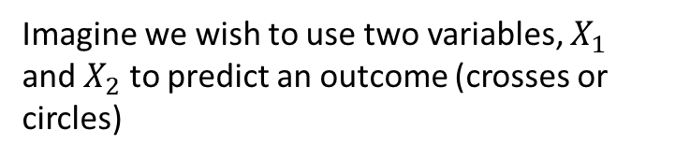
In-sample optimism and Overfitting
Imagine we wish to use two variables, $X_{1}$ and $X_{2}$ to predict an outcome (crosses or circles)
Then we could fit a line through these points and say that we classify/predict any point below the line to be a cross and above to be a circle.
Clearly, this rule is correct for all the circles, but it would misclassify some of the crosses.

Slide 25
In-sample optimism and Overfitting
Therefore, we could take this a step further and fit a curve rather than a line.
Here the situation is improved, but it still would misclassify some of the crosses and now also misclassifies one of the circles.

Slide 26
In-sample optimism and Overfitting
So why not take this to the extreme and make the classifier (i.e. CPM) look like this?
Here all points are now correctly classified.
However, what would happen if we used this to predict new data? Chances are, the new data won’t look exactly like this, so the model wouldn't work very well
This is an example of overfitting and is why we need robust internal and external validation.
Remember: we should always check the performance of a CPM using data that has not been used for model derivation/development.

Slide 27
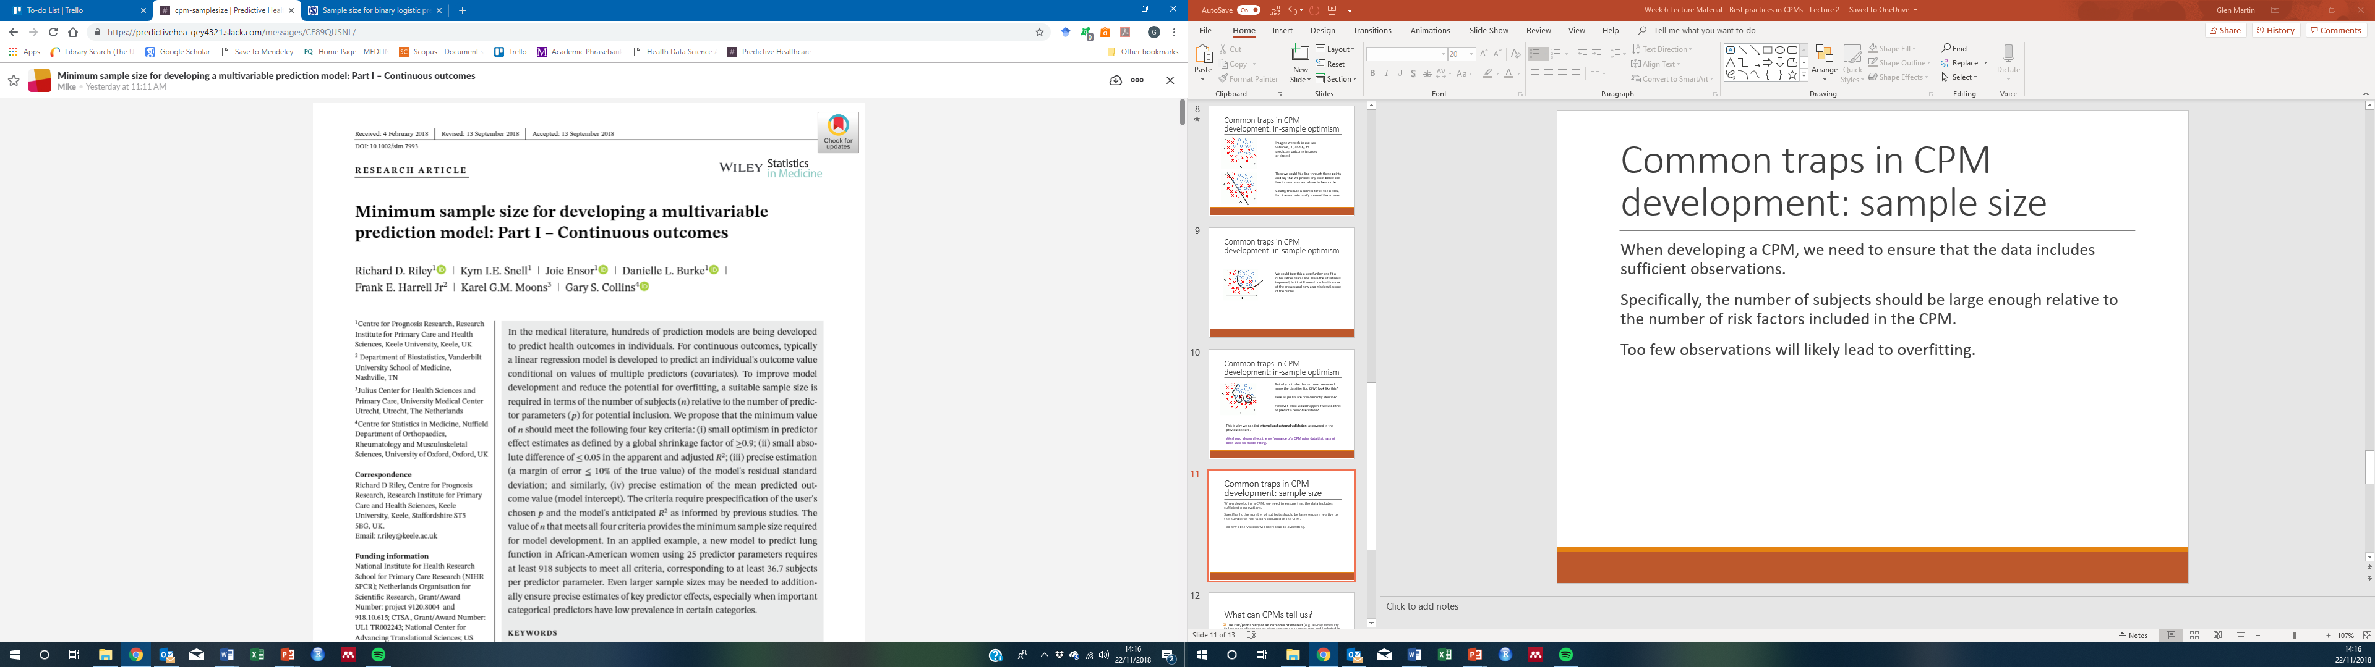
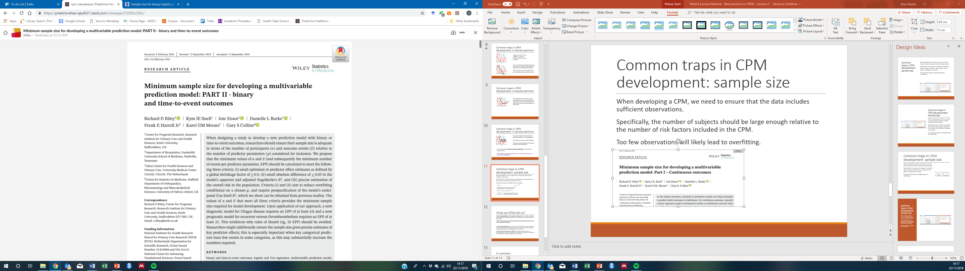
Sample size
Developing a CPM on insufficient data is a sure way to have a overfit and poor performing model

Slide 28
What can CPMs tell us?
The risk/probability of an outcome of interest (e.g. 30-day mortality following cardiac surgery) given the variables measured and included in the CPM
Risk factors that are associated with increased/decreased risk of the outcome being modelled
But not:
Causal interpretations (e.g. “if we start treatment your risk according to the CPM will be lowered by X%”) – methods emerging in this space from our research group

Slide 29
Reporting of CPMs

Slide 30
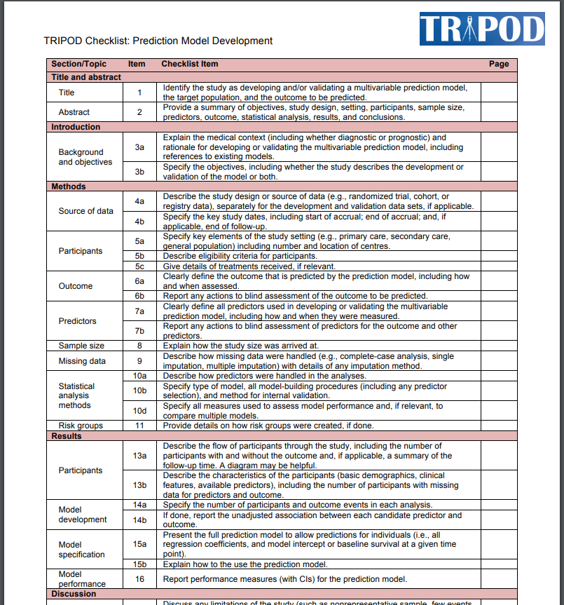
Documents how a CPM should be reported for both development and validation

Slide 31
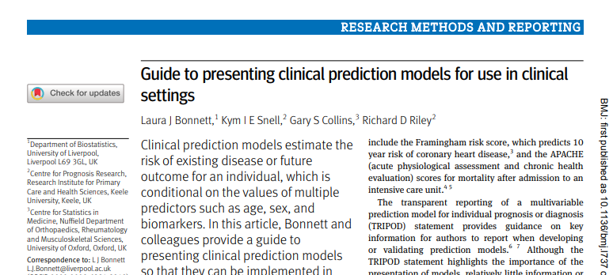
Clear presentation of a CPM is key, but receives limited attention in literature
Presentation of the full model equation is essential
Many ways to do this
Notes:
e.g. graphical scoring chart, nomogram, website/applications

Slide 32
Take Home Messages
Robust validation (in both internal and external settings) is fundamental in the CPM development pipeline
Calibration and Discrimination should be assessed and both are equally important in assessing predictive performance
There are many common pitfalls to avoid in prediction research: keeping abreast of the literature and consulting experts is key
Careful consideration should be given to reporting the model, making use of the TRIPOD guidelines when writing a manuscript

Slide 33



Thank you
Glen Martin
Centre for Health Informatics
The University of Manchester, UK
glen.martin@manchester.ac.uk
@glen_martin1

